Slide 1
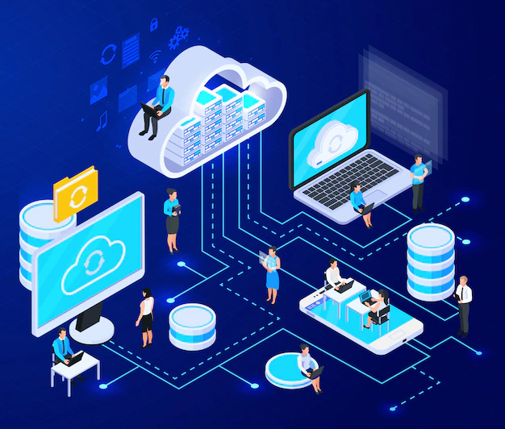
Cloud Computing

Slide 2
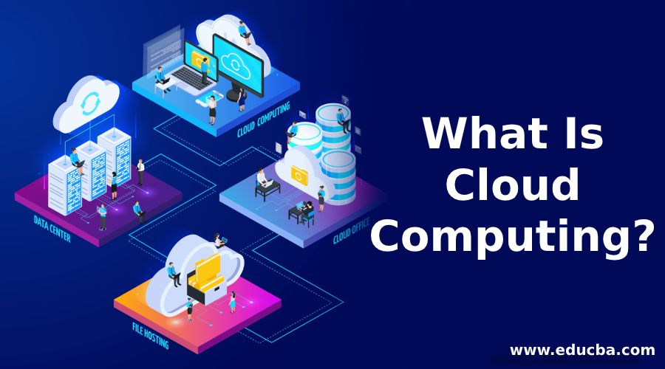
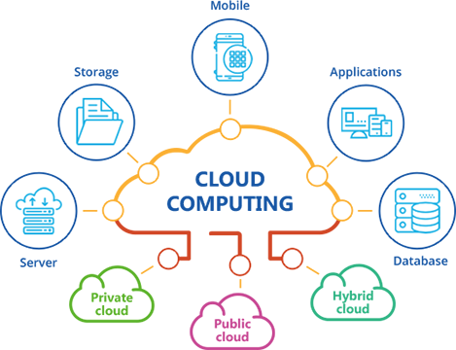
Introduction to Cloud Computing
Cloud computing is a general term for anything that involves delivering hosted services over the internet.
Cloud computing is the delivery of different services through the Internet. These resources include tools and applications like data storage, servers, databases, networking, and software.

Slide 3
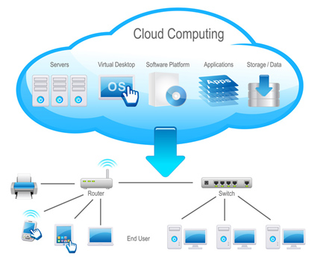
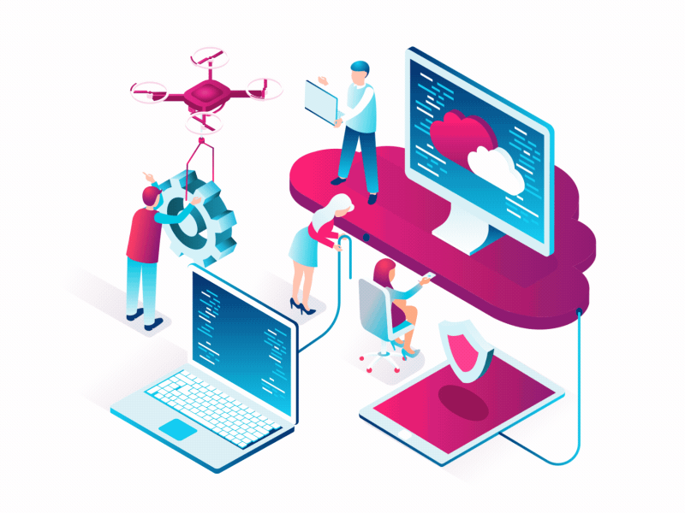
How Cloud Computing Works?
Cloud computing works by having companies host or maintain massive data centers that provide the security, storage capacity and computing power to support cloud infrastructure. Clients pay for the rights to use their clouds along with an ecosystem to communicate between devices and programs.

Slide 4
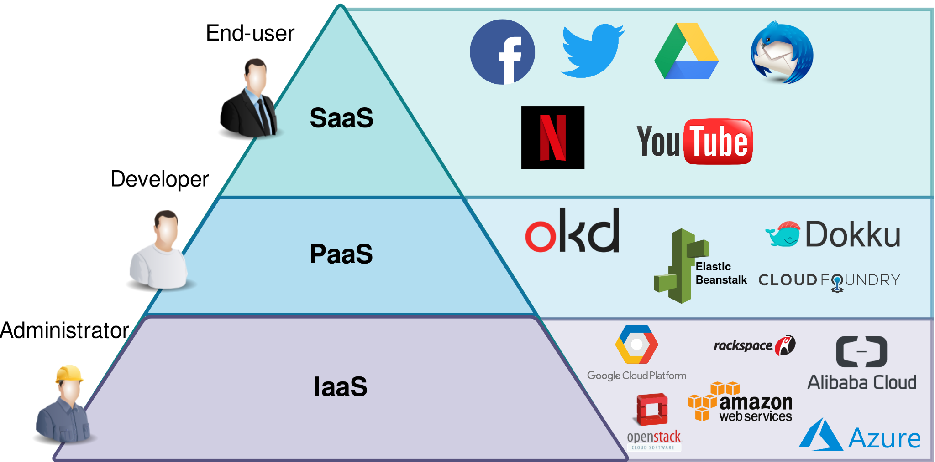
What do Cloud Computing services do ?
Cloud Computing Services fall in three categories:
IaaS: Infrastructure as a Service, Offering virtualized software and servers to people.
PaaS: Platform as a Service, PaaS is the same as IaaS, but with the addition of the application layer, which the customer intends to use.
SaaS: Software as a Service, SaaS is offering software to the others remotely as a Web-based service.

Slide 5
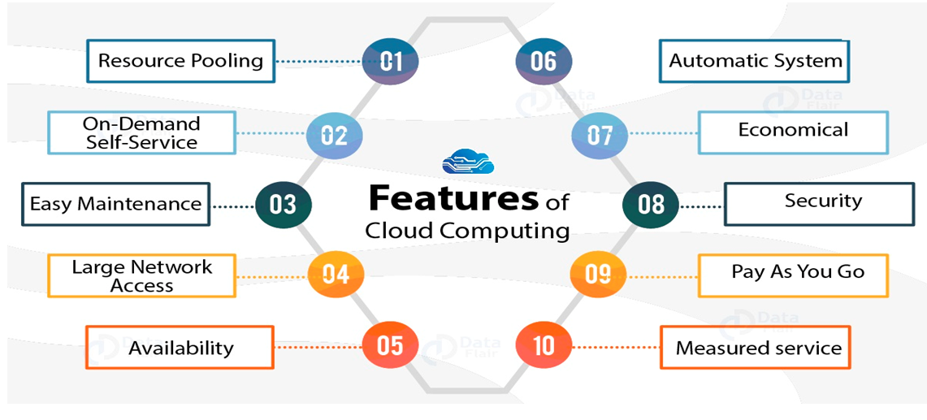
Some features of cloud computing:-
-Cost effective (pay as you go)
-Automation
-Easy maintenance
-Remote data backup /
disaster recovery
-Secured and economical
-Speed
-Reliability

Slide 6
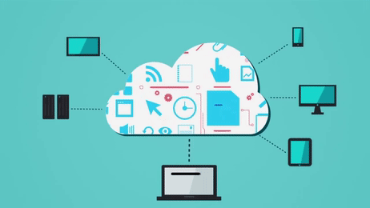
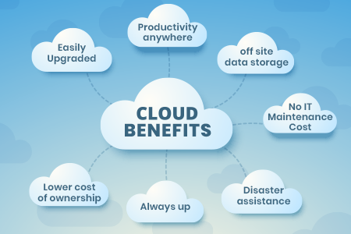
Benefits of Cloud Computing
This allows users to access services from wherever they are via a web connection to a cloud platform using almost any device.

Slide 7
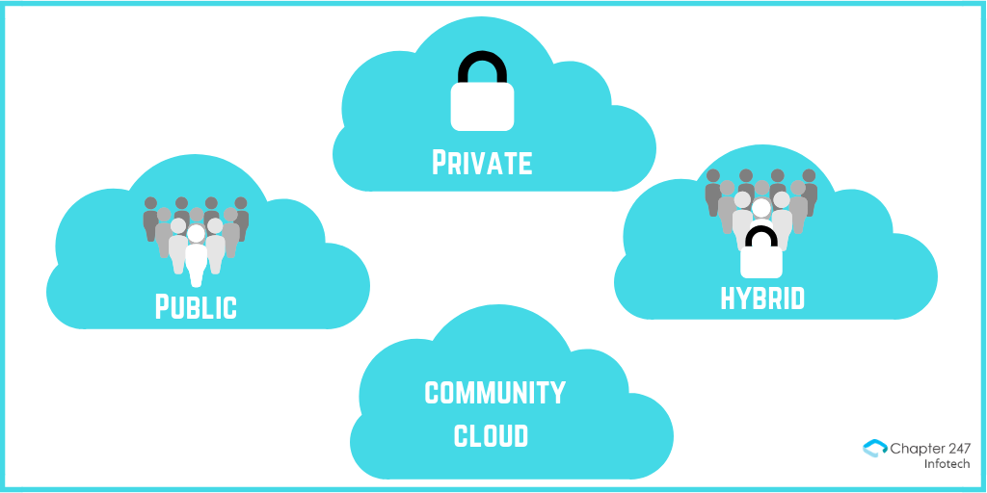
Cloud Computing Technologies and Types:-
There are four main types of cloud computing:
1.Private Cloud
2.Public Cloud
3.Hybrid Cloud
4.Community Cloud

Slide 8
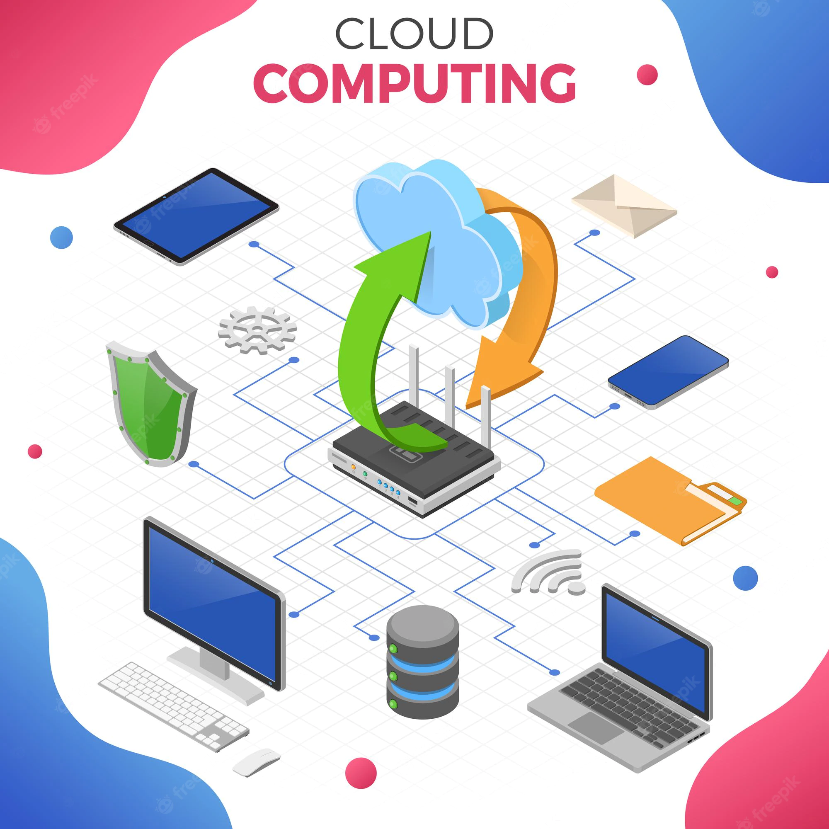
Future of cloud computing?
-Better cloud services
-Security
-Virtualization
-Modular software development
-Market growth
-Cloud technology and safer collaboration

Slide 9
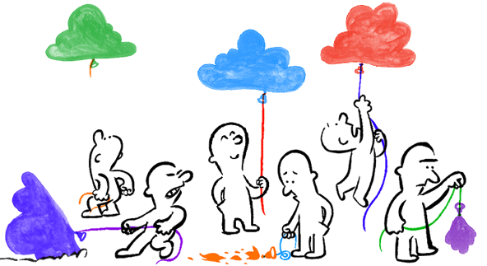
Drawbacks of Cloud Computing:-
-Requires an Internet connection (High speed)
-Lack of support
-Data leakage
-Account or service hijacking
-Technology vulnerabilities

Slide 10
💀💀💀
ThankYou

